Slide 1
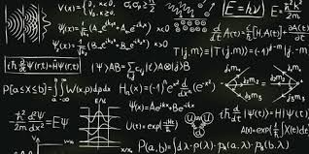
FISIKA KUANTUM
Muhammad Zamrun F.
Phone: 0813-4190-1977
Email : mzamrun@gmail.com
Office hours: after class
Or email me
Or sms/WA on my cell phone
anytime!

Slide 2
BEBERAPA HAL YANG PERLU DIPERHATIKAN BERKAITAN DENGAN KULIAH INI

Slide 3
TEXT BOOK
Buku teks :
Gasiorowicz, Stephen (2003). Quantum Physics (3rd ed.). Wiley
Sakurai, J. J.; Napolitano, Jim (2017). Modern Quantum Mechanics (2nd ed.). Cambridge University Press
Goswami, A. (1997), Quantum Mechanics, Second Edition, Wm. C. Brown
Buku/sumber lain mengenai fisika kuantum.

Slide 4

PEKERJAAN RUMAH & QUIZ
Pekerjaan rumah disetor pada hari yang telah ditentukan — Bukan dikelas atau di bawah pintu saya.
Disarankan kerja sama (tetapi ditulis sendiri)
Dua kali (sebelum UTS dan sebelum UAS)
Quiz- jika ada dua kali
Sebelum UTS
Sebelum UAS

Slide 5

HARUS HADIR DI KELAS
Akan ada banyak penjelasan yang tidak tercantum dalam power point presentation

Slide 6


Untuk memahami materi secara menyeluruh selalu dibutuhkan pemahaman materi kuliah2 sebelumnya
JIka hal ini dilakukan maka mahasiswa tidak akan mengalami hal seperti ini pada malam sebelum ujian.
Notes:
Image from http://groups.msn.com/AGODFIGHTforallreligions/membersinformationrules.msnw (I don’t recommend this site for anything other than this picture.)

Slide 7
PENILAIAN
QUIZ+PR : 20%
UTS : 30% : 40%
UAS : 50% : 40%
TOTAL : 100%

Slide 8
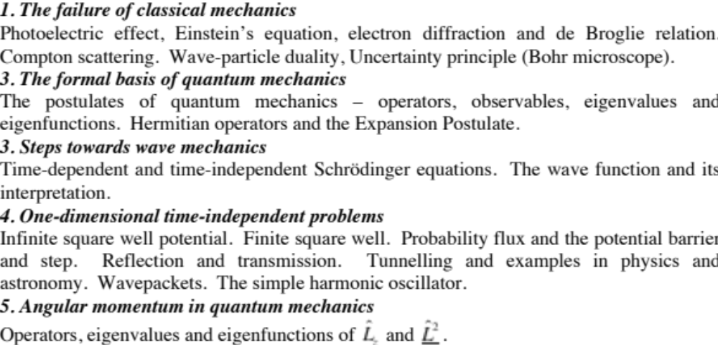
SYLLABUS

Slide 9
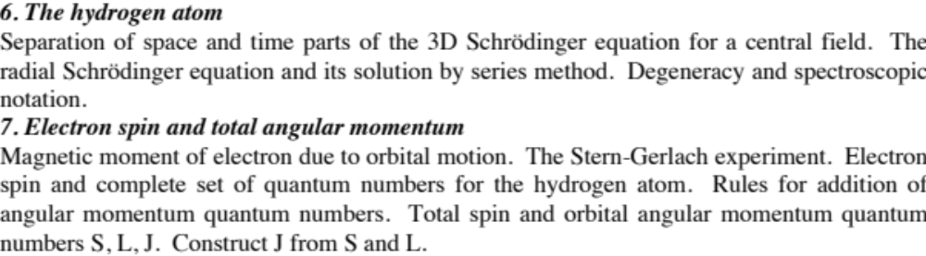
SYLLABUS (cont)

Slide 10

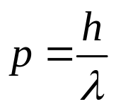


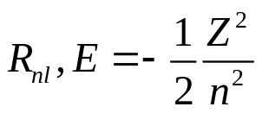

Photo-electric effect, Compton scattering
Davisson-Germer experiment, double-slit experiment
Particle nature of light in quantum mechanics
Wave nature of matter in quantum mechanics
Wave-particle duality
Time-dependent Schrödinger equation, Born interpretation
Postulates:
Operators,eigenvalues and eigenfunctions, expansions in complete sets, commutators, expectation values, time evolution
2246 Maths Methods III
Separation of variables
Time-independent Schrödinger equation
Frobenius method
Quantum simple harmonic oscillator
Legendre equation
Hydrogenic atom
1D problems
2246
Angular momentum operators
Radial solution
Angular solution

Slide 11
WAVE PARTICLE DUALITY
Evidence for wave-particle duality
Photoelectric effect
Compton effect
Electron diffraction
Interference of matter-waves
Consequence: Heisenberg uncertainty principle

Slide 12

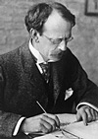
PHOTOELECTRIC EFFECT
Hertz
J.J. Thomson
When UV light is shone on a metal plate in a vacuum, it emits charged particles (Hertz 1887), which were later shown to be electrons by J.J. Thomson (1899).
Vacuum chamber
Light, frequency ν
Classical expectations
Collecting plate
Electric field E of light exerts force F=-eE on electrons. As intensity of light increases, force increases, so KE of ejected electrons should increase.
Metal plate
Electrons should be emitted whatever the frequency ν of the light, so long as E is sufficiently large
I
Ammeter
For very low intensities, expect a time lag between light exposure and emission, while electrons absorb enough energy to escape from material
Potentiostat

Slide 13
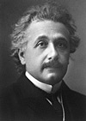

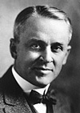


PHOTOELECTRIC EFFECT (cont)
Einstein
Actual results:
Einstein’s interpretation (1905):
Light comes in packets of energy (photons)
Maximum KE of ejected electrons is independent of intensity, but dependent on ν
For ν<ν₀ (i.e. for frequencies below a cut-off frequency) no electrons are emitted
Millikan
An electron absorbs a single photon to leave the material
There is no time lag. However, rate of ejection of electrons depends on light intensity.
The maximum KE of an emitted electron is then
Work function: minimum energy needed for electron to escape from metal (depends on material, but usually 2-5eV)
Verified in detail through subsequent experiments by Millikan
Planck constant: universal constant of nature

Slide 14
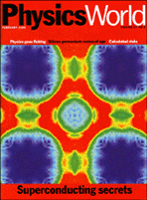
Photoemission experiments today
Modern successor to original photoelectric effect experiments is ARPES (Angle-Resolved Photoemission Spectroscopy)
February 2000
Emitted electrons give information on distribution of electrons within a material as a function of energy and momentum

Slide 15

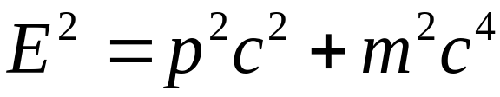
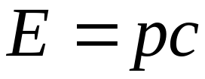

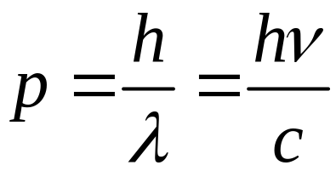
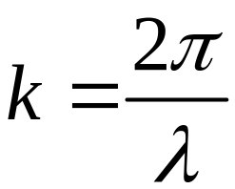
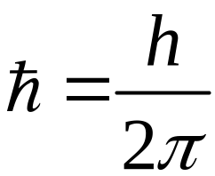



SUMMARY OF PHOTON PROPERTIES
Relation between particle and wave properties of light
Energy and frequency
Also have relation between momentum and wavelength
Relativistic formula relating
energy and momentum
For light
and
Also commonly write these as
wavevector
angular frequency
hbar

Slide 16
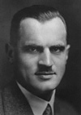
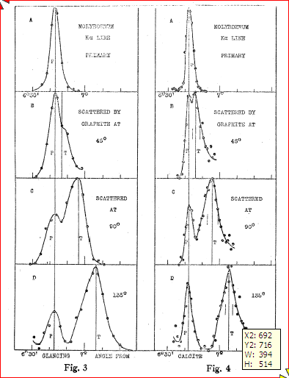
COMPTON SCATTERING
Compton
Compton (1923) measured intensity of scattered X-rays from solid target, as function of wavelength for different angles. He won the 1927 Nobel prize.
X-ray source
Collimator (selects angle)
Crystal (selects wavelength)
θ
Target
Detector
Result: peak in scattered radiation shifts to longer wavelength than source. Amount depends on θ (but not on the target material).
A.H. Compton, Phys. Rev. 22 409 (1923)

Slide 17
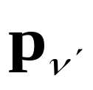

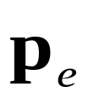
COMPTON SCATTERING (cont)
Classical picture: oscillating electromagnetic field causes oscillations in positions of charged particles, which re-radiate in all directions at same frequency and wavelength as incident radiation.
Change in wavelength of scattered light is completely unexpected classically
Incident light wave
Oscillating electron
Emitted light wave
Compton’s explanation: “billiard ball” collisions between particles of light (X-ray photons) and electrons in the material
Before
After
scattered photon
Incoming photon
θ
Electron
scattered electron

Slide 18
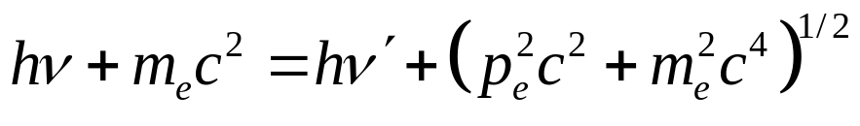
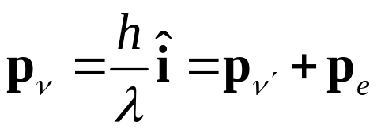
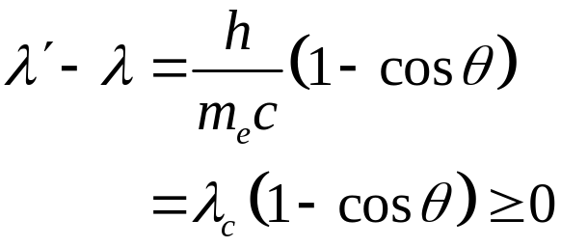
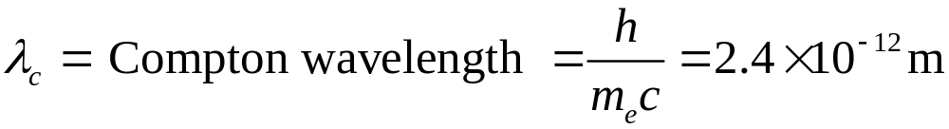
COMPTON SCATTERING (cont)
Before
After
scattered photon
Incoming photon
θ
Electron
scattered electron
Conservation of energy
Conservation of momentum
From this Compton derived the change in wavelength

Slide 19
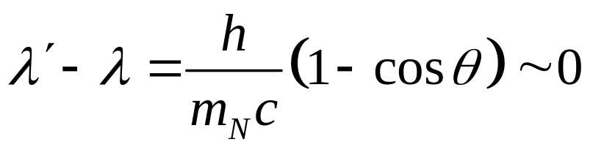
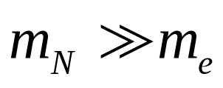
COMPTON SCATTERING
(cont)
Note that, at all angles
there is also an unshifted peak.
This comes from a collision between the X-ray photon and the nucleus of the atom
since

Slide 20
WAVE-PARTICLE DUALITY OF LIGHT
In 1924 Einstein wrote:- “ There are therefore now two theories of light, both indispensable, and … without any logical connection.”
Evidence for wave-nature of light
Diffraction and interference
Evidence for particle-nature of light
Photoelectric effect
Compton effect
Light exhibits diffraction and interference phenomena that are only explicable in terms of wave properties
Light is always detected as packets (photons); if we look, we never observe half a photon
Number of photons proportional to energy density (i.e. to square of electromagnetic field strength)

Slide 21
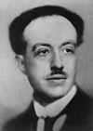
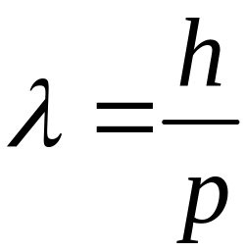

De Broglie
MATTER WAVES
We have seen that light comes in discrete units (photons) with
particle properties (energy and momentum) that are related to the
wave-like properties of frequency and wavelength.
In 1923 Prince Louis de Broglie postulated that ordinary matter can have
wave-like properties, with the wavelength λ related to momentum
p in the same way as for light
de Broglie relation
Planck’s constant
de Broglie wavelength
NB wavelength depends on momentum, not on the physical size of the particle
Prediction: We should see diffraction and interference of matter waves

Slide 22
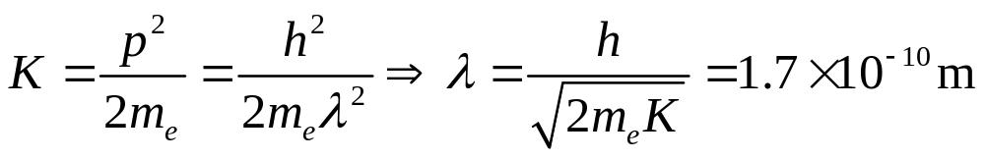
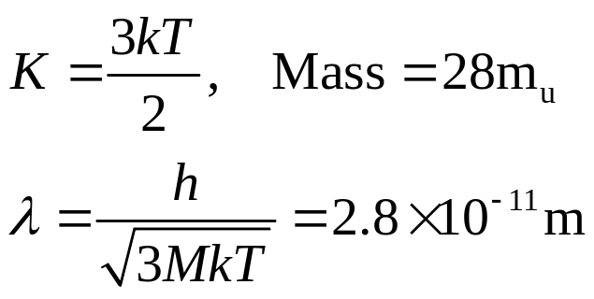
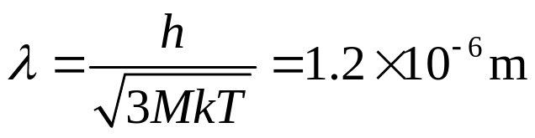
Estimate some de Broglie wavelengths
Wavelength of electron with 50eV kinetic energy
Wavelength of Nitrogen molecule at room temperature
Wavelength of Rubidium(87) atom at 50nK

Slide 23
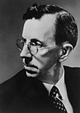
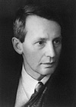
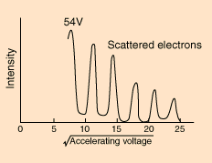
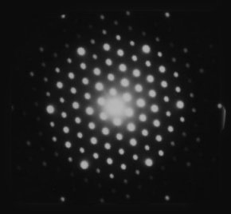
ELECTRON DIFFRACTION
The Davisson-Germer experiment (1927)
The Davisson-Germer experiment: scattering a beam of electrons from a Ni crystal. Davisson got the 1937 Nobel prize.
Davisson
G.P. Thomson
θ_{i}
θ_{i}
At fixed angle, find sharp peaks in intensity as a function of electron energy
Davisson, C. J., "Are Electrons Waves?," Franklin Institute Journal 205, 597 (1928)
At fixed accelerating voltage (fixed electron energy) find a pattern of sharp reflected beams from the crystal
G.P. Thomson performed similar interference experiments with thin-film samples

Slide 24




ELECTRON DIFFRACTION (cont)
Interpretation: similar to Bragg scattering of X-rays from crystals
θ_{i}
Path difference:
θ_{r}
Constructive interference when
a
Electron scattering dominated by surface layers
Note difference from usual “Bragg’s Law” geometry: the identical scattering planes are oriented perpendicular to the surface
Note θ_{i} and θ_{r} not necessarily equal

Slide 25

THE DOUBLE-SLIT EXPERIMENT
Originally performed by Young (1801) to demonstrate the wave-nature of light. Has now been done with electrons, neutrons, He atoms among others.
Alternative method of detection: scan a detector across the plane and record number of arrivals at each point
y
d
θ
Incoming coherent beam of particles (or light)
Detecting screen
D
For particles we expect two peaks, for waves an interference pattern

Slide 26
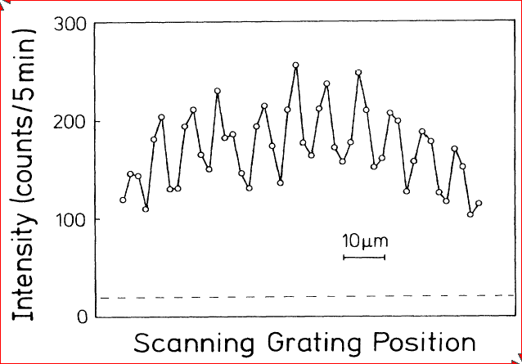
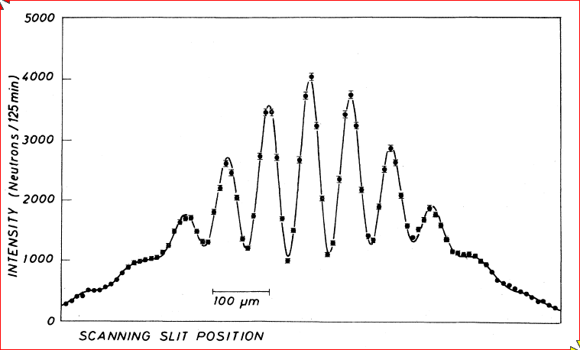
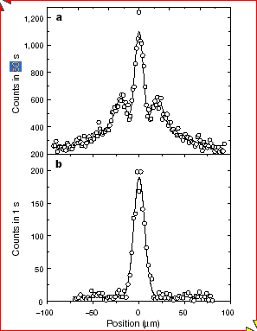
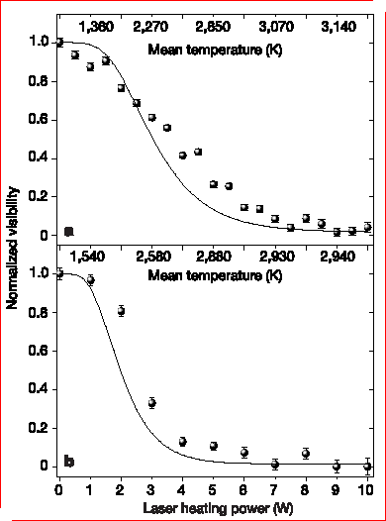
EXPERIMENTAL RESULTS
Neutrons, A Zeilinger et al. 1988 Reviews of Modern Physics 60 1067-1073
He atoms: O Carnal and J Mlynek 1991 Physical Review Letters 66 2689-2692
C₆₀ molecules: M Arndt et al. 1999 Nature 401 680-682
Fringe visibility decreases as molecules are heated. L. Hackermüller et al. 2004 Nature 427 711-714
With multiple-slit grating
Without grating
Interference patterns can not be explained classically - clear demonstration of matter waves

Slide 27


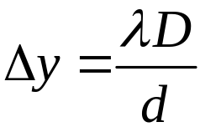

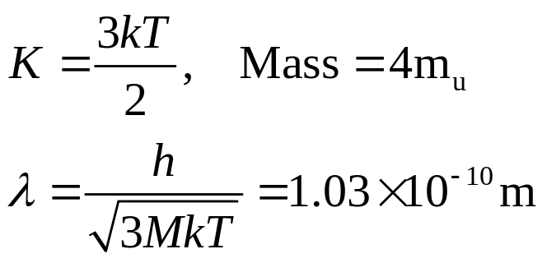

DOUBLE-SLIT EXPERIMENT WITH HELIUM ATOMS
(Carnal & Mlynek, 1991,Phys.Rev.Lett.,66,p2689)
Path difference:
Constructive interference:
Separation between maxima:
y
(proof following)
Experiment: He atoms at 83K, with d=8μm and D=64cm
d
θ
Measured separation:
Predicted de Broglie wavelength:
D
Predicted separation:
Good agreement with experiment

Slide 28

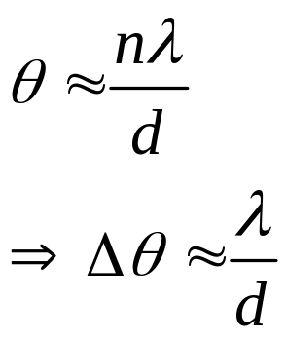

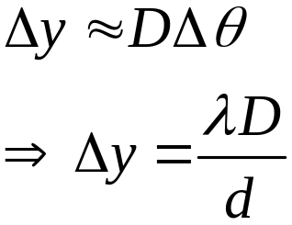
FRINGE SPACING IN
DOUBLE-SLIT EXPERIMENT
Maxima when:
so use small angle approximation
y
d
θ
Position on screen:
So separation between adjacent maxima:
D

Slide 29
DOUBLE-SLIT EXPERIMENT
INTERPRETATION
The flux of particles arriving at the slits can be reduced so that only one particle arrives at a time. Interference fringes are still observed!
  Wave-behaviour can be shown by a single atom.
  Each particle goes through both slits at once.
A matter wave can interfere with itself.
Hence matter-waves are distinct from H₂O molecules collectively
giving rise to water waves.
Wavelength of matter wave unconnected to any internal size of particle. Instead it is determined by the momentum.
If we try to find out which slit the particle goes through the interference pattern vanishes!
We cannot see the wave/particle nature at the same time.
If we know which path the particle takes, we lose the fringes .
The importance of the two-slit experiment has been memorably summarized
by Richard Feynman: “…a phenomenon which is impossible, absolutely impossible,
to explain in any classical way, and which has in it the heart of quantum mechanics.
In reality it contains the only mystery.”

Slide 30
DOUBLE-SLIT EXPERIMENT
BIBLIOGRAPHY
Some key papers in the development of the double-slit experiment during the 20th century:
Performed with a light source so faint that only one photon exists in the apparatus at any one time
G I Taylor 1909 Proceedings of the Cambridge Philosophical Society 15 114-115
Performed with electrons
C Jönsson 1961 Zeitschrift für Physik 161 454-474,
(translated 1974 American Journal of Physics 42 4-11)
Performed with single electrons
A Tonomura et al. 1989 American Journal of Physics 57 117-120
Performed with neutrons
A Zeilinger et al. 1988 Reviews of Modern Physics 60 1067-1073
Performed with He atoms
O Carnal and J Mlynek 1991 Physical Review Letters 66 2689-2692
Performed with C60 molecules
M Arndt et al. 1999 Nature 401 680-682
Performed with C70 molecules showing reduction in fringe visibility as temperature rises
and the molecules “give away” their position by emitting photons
L. Hackermüller et al 2004 Nature 427 711-714
Performed with Na Bose-Einstein Condensates
M R Andrews et al. 1997 Science 275 637-641
An excellent summary is available in Physics World (September 2002 issue, page 15)
and at http://physicsweb.org/ (readers voted the double-slit experiment “the most beautiful in physics”).

Slide 31
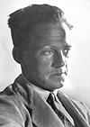

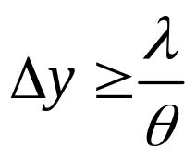
HEISENBERG MICROSCOPE AND
THE UNCERTAINTY PRINCIPLE
(also called the Bohr microscope, but the thought
experiment is mainly due to Heisenberg).
The microscope is an imaginary device to measure
the position (y) and momentum (p) of a particle.
Heisenberg
Particle
θ/2
Light source, wavelength λ
Resolving power of lens:
Lens, with angular diameter θ

Slide 32


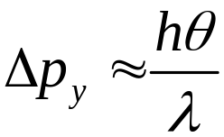

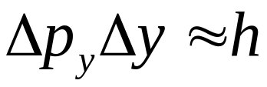
HEISENBERG MICROSCOPE (cont)
Photons transfer momentum to the particle when they scatter.
Magnitude of p is the same before and after the collision. Why?
p
Uncertainty in photon y-momentum
= Uncertainty in particle y-momentum
θ/2
p
Small angle approximation
de Broglie relation gives
and so
From before
hence
HEISENBERG UNCERTAINTY PRINCIPLE.

Slide 33
Point for discussion
The thought experiment seems to imply that, while prior to experiment we have well defined values, it is the act of measurement which introduces the uncertainty by disturbing the particle’s position and momentum.
Nowadays it is more widely accepted that quantum uncertainty (lack of determinism) is intrinsic to the theory.

Slide 34
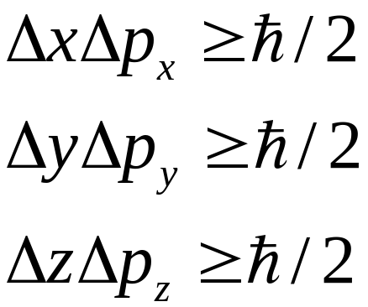
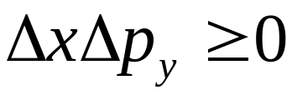
HEISENBERG UNCERTAINTY PRINCIPLE
We will show formally (section 4)
HEISENBERG UNCERTAINTY PRINCIPLE.
We cannot have simultaneous knowledge
of ‘conjugate’ variables such as position and momenta.
Note, however,
etc
Arbitary precision is possible in principle for
position in one direction and momentum in another

Slide 35
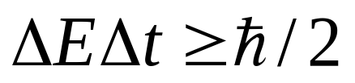




HEISENBERG UNCERTAINTY PRINCIPLE
There is also an energy-time uncertainty relation
Transitions between energy levels of atoms are not perfectly sharp in frequency.
n = 3
An electron in n = 3 will spontaneously
decay to a lower level after a lifetime
of order
n = 2
n = 1
Intensity
There is a corresponding ‘spread’ in
the emitted frequency
Frequency

Slide 36
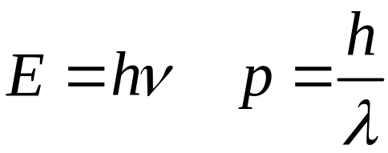
CONCLUSIONS
Light and matter exhibit wave-particle duality
Relation between wave and particle properties
given by the de Broglie relations
,
Evidence for particle properties of light
Photoelectric effect, Compton scattering
Evidence for wave properties of matter
Electron diffraction, interference of matter waves
(electrons, neutrons, He atoms, C60 molecules)
Heisenberg uncertainty principle limits
simultaneous knowledge of conjugate variables

